Slide 1

Class logistics and Review
Nov 5, 2019

Slide 2

If you love data analysis, here’s a fun plan for spring break 2020…

Slide 3
Outline
Lab 6, Homework 6
Class Schedule
Presentations and Take-home Final
Data Assimilation Lecture

Slide 4
Optional MCMC: 1-D, Known Answer
Test your understanding of this by running Lab 6.3 (based on Brian’s MCMCexample_noQN.m code, which calls evalBayes.m)
This uses known Gaussian or Uniform distributions (try picking each) to theoretically calculate the posterior and then uses MCMC to get to the same posterior
Change parameters and see how well MCMC fits the posterior each time. Try to figure out what controls the skill of the MCMC performance.

Slide 5
Try a 2 parameter set for determining Lyell Streamflow
Look at Lab 6.2
Modify some of the assumptions and re-run it
The lab, like the class lecture, is focused only on the upper section of the rating curve. You could modify it to look only at the lower section. (Unless you want to write your own code to use MCMC to find a third parameter for the break-point, just use the same cut-off I did.)

Slide 6
On Rating Curves: Homework 6
Homework 6, problem 2, you’re comparing 3 ways of coming up with a rating curve
Your log-transform least-squares fit has uncertainty similar to earlier homework assignments (just be careful with the log transformation)
Brute-force montecarlo parameter estimation can give you a local minimum but not a good uncertainty value
MCMC output will give you an ensemble of parameters (pairs of a and b) that can be used to make an ensemble of discharge estimates for any value of h. Pick a low, medium, and high h value (i.e., low, medium and high discharge value) and take your entire MCMC ensemble of Q values, order by rank, and make empirical CDFs to get 95% confidence intervals. These you can directly compare with the least-squares 95% confidence for those same Q predictions.

Slide 7
On Rating Curves: What do “real” people do?
In Reading/Rating Curve Analysis:
“Rantz_streamflow_chapter15_vol2a.pdf” has the official methodology of the USGS (1982)
This is a log-transform least-squares fit, with break-points determined by eye
“Mason_etal_2016_compare_rating_curve” is a recent conference proceeding by a team from the USGS stating that they are re-evaluating their methods
From my read of the paper, they prefer BaRatin and MCMC analysis as the path forward, which is what I’m teaching you here

Slide 8
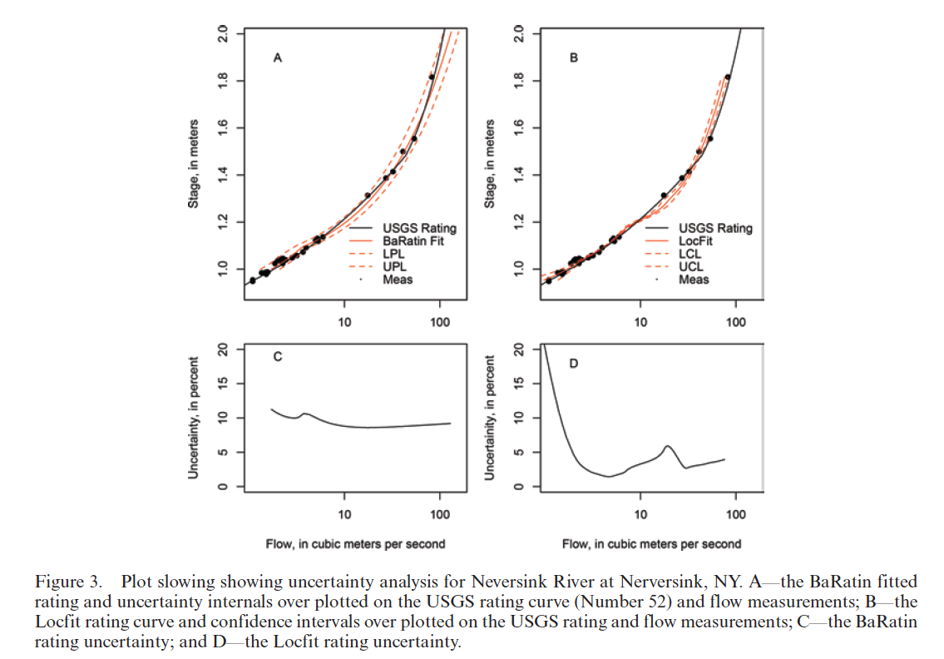
From Mason et al. 2016
With LOWESS fit repeated 500 times and a Gaussian mixture model, see Coxon 2015 paper
Bayesian MCMC (BaRatin)

Slide 9
Outline
Lab 6, Homework 6, MCMC
Class Schedule
Presentations and Take-home Final
Data Assimilation Lecture

Slide 10
7 | Data Assimilation | 11/6 11/7: Assn 6 Due
8 | Principles of EOFs, PCs, Timeseries Analysis Lab on Applying Empirical Orthogonal Functions (EOFs) and Principal Components (PCs) | 11/12: 11/14: Assn 7 Due (Project Update 2)
9 | Fourier Transforms; Power Spectra, Timeseries analysis | 11/19 11/21: Assn 8 Due
10 | Graphics and Visualization (H&H Ch 16) Tips and Tricks | 11/26 Presentations 11/28: Holiday!
11 | Data Analysis Applications: Student Presentations (Jessica away from campus) | 12/3: Presentations 12/5: Presentations 12/9: Final Project Due 12/9: Final Exam Due

Slide 11
Each of these subjects is a class unto itself – use this class as an idea of what you might need/want to study in more depth
7 | Data Assimilation | 11/6 11/7: Assn 6 Due
These were picked as “things Jessica finds most useful in water science”
8 | Principles of EOFs, PCs, Timeseries Analysis Lab on Applying Empirical Orthogonal Functions (EOFs) and Principal Components (PCs) | 11/12: 11/14: Assn 7 Due (Project Update 2)
9 | Fourier Transforms; Power Spectra, Timeseries analysis | 11/19 11/21: Assn 8 Due
10 | Graphics and Visualization (H&H Ch 16) Tips and Tricks | 11/26 Presentations 11/28: Holiday!
11 | Data Analysis Applications: Student Presentations (Jessica away from campus) | 12/3: Presentations 12/5: Presentations 12/9: Final Project Due 12/9: Final Exam Due

Slide 12
Projects
I’m working on feedback to your Homework 5 project updates
Next project updates are due the 14th (homework 7) – note that undergrads also have some practice final exam questions to do instead on this one.
Presentations will be graded by your peers. Final reports (10 pages) will be graded by me.

Slide 13
Person 1 | Person 2 | Project Idea |  |  |  |  |  |  |  |  |  | Presentation Day
Indira Bose | Lindsay Swanson | Forests, Floods, Clear-cutting |  |  |  |  |  |  |  |  |  | 26-Nov
Valerie Chang | Nicole Loo | Snow, forests, soil moisture |  |  |  |  |  |  |  |  |  | 26-Nov
Yanjia Yang | Porranee Thanapakpawin | Phosphorous in lakes |  |  |  |  |  |  |  |  |  | 26-Nov
Samantha Fung | James McVey | High arsenic in Lake Killarney |  |  |  |  |  |  |  |  |  | 26-Nov
Friedrich Knuth | Shashank Bhushan | Glaciers |  |  |  |  |  |  |  |  |  | 26-Nov
David Freidlander | Hedda Hagman | Stream temperature and snowmelt |  |  |  |  |  |  |  |  |  | 3-Dec
Drew Bruman | Leily Mojarab | Stream temperature and snowmelt |  |  |  |  |  |  |  |  |  | 3-Dec
Lightman He | Ximin Hu | Stream temperature and snowmelt |  |  |  |  |  |  |  |  |  | 3-Dec
Vivian Griffey | Jane Harrell | Columbia Streamflow and Climate Change |  |  |  |  |  |  |  |  |  | 3-Dec
Bejin Bekbulat |  | Air Pollution |  |  |  |  |  |  |  |  |  | 3-Dec
Michelle Hu | Joe Meyer | Glaciers or similar |  |  |  |  |  |  |  |  |  | 5-Dec
Lars Berglund | Mia El-Kazan | Effects of early snowmelt on fish |  |  |  |  |  |  |  |  |  | 5-Dec
Junrun Chen | Suykong Yun | Human Migration towards water |  |  |  |  |  |  |  |  |  | 5-Dec
Gus Friedman | Tessa Picarella | Forest Harvesting and Summer low flows |  |  |  |  |  |  |  |  |  | 5-Dec
Lin Wang | Hal Yuan | Forests and Floods |  |  |  |  |  |  |  |  |  | 5-Dec
Everyone, including undergrads, will get participation credit for writing comments and evaluating each presentation (using a form on canvas).
Presentations will be 12-minutes of presenting, with 4 minutes for questions, then 4 minutes for evaluation. With 5 presentations per day, we must stay on time. -- This schedule is online in the Projects and Presentations folder.

Slide 14
HJ Andrews: Forests & Streamflow
Example Approach for Projects:
I’ll focus on analyses of the small basins included in the HJ Andrews dataset.
Note that literature also debates large basins, which I will not discuss here.

Slide 15
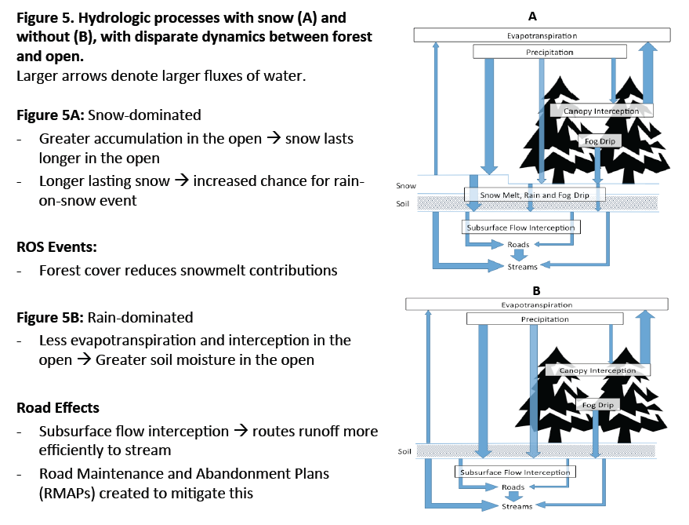
What are the basic processes?
Start with the science, what do you know:
From Gwyn Perry report, 2016

Slide 16
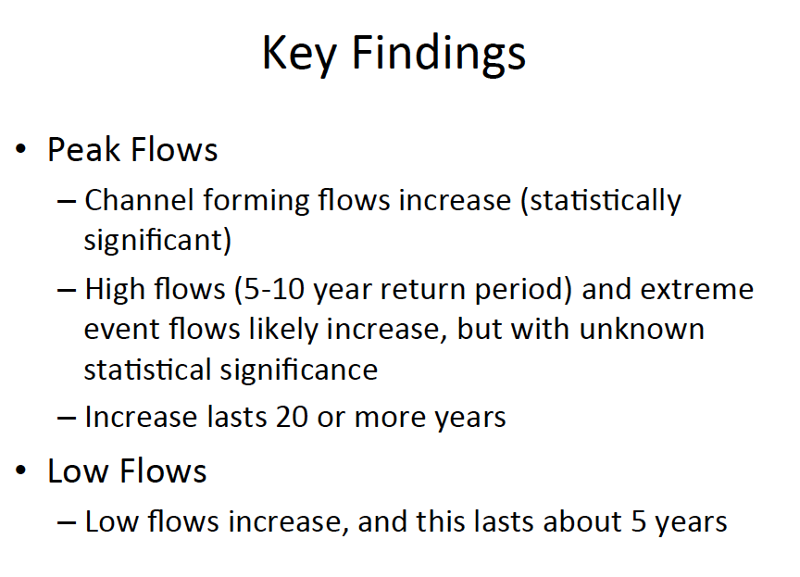
From Perry et al. 2016 lit review
Read published literature on your topic:

Slide 17
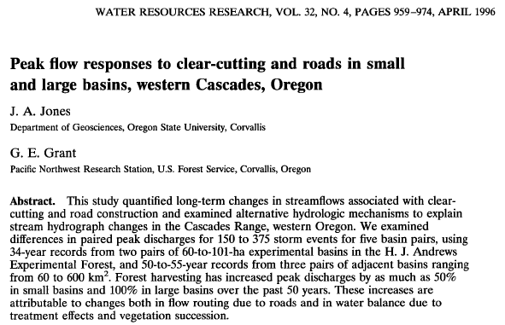
What have other people done?
Look at the specific tools other people have used:

Slide 18
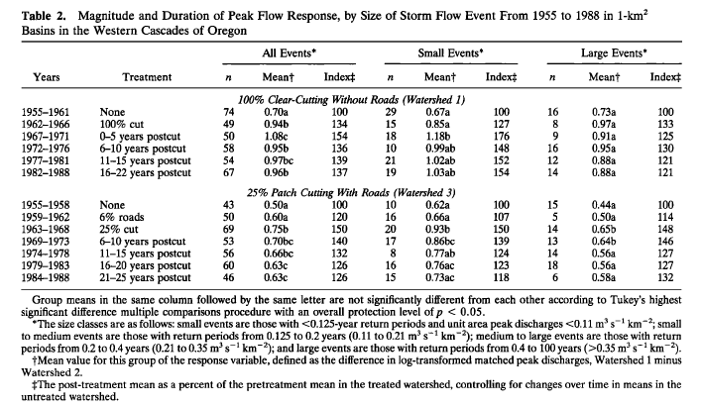
WS 1,2,&3, Identified “events” and performed ANOVA on log(flow_treated) – log(flow_control)

Slide 19
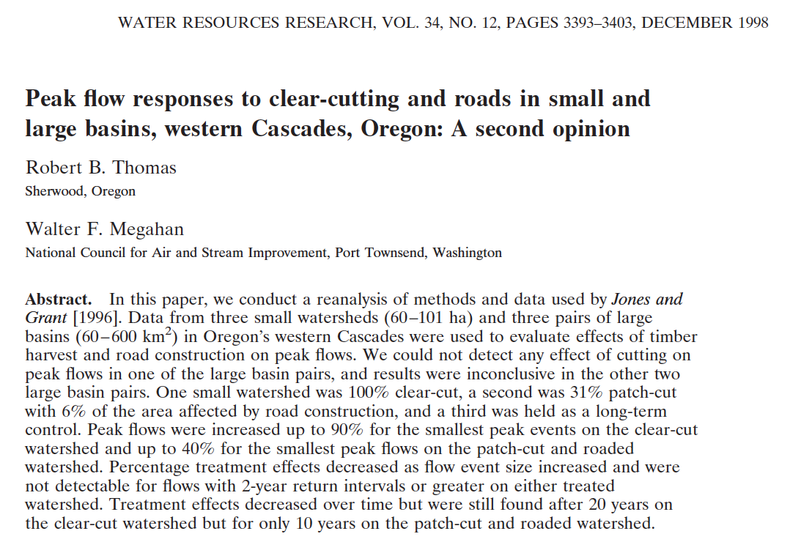
Look at where there’s disagreement about the best approach:

Slide 20
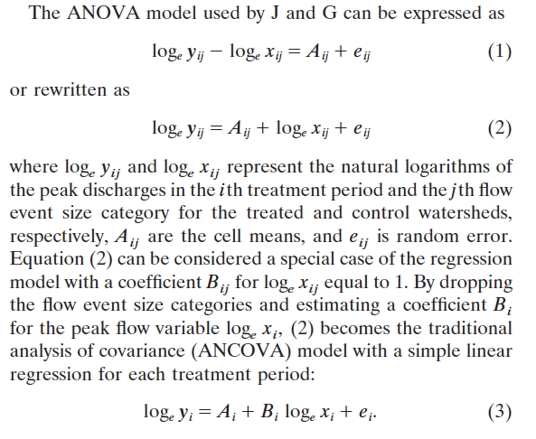
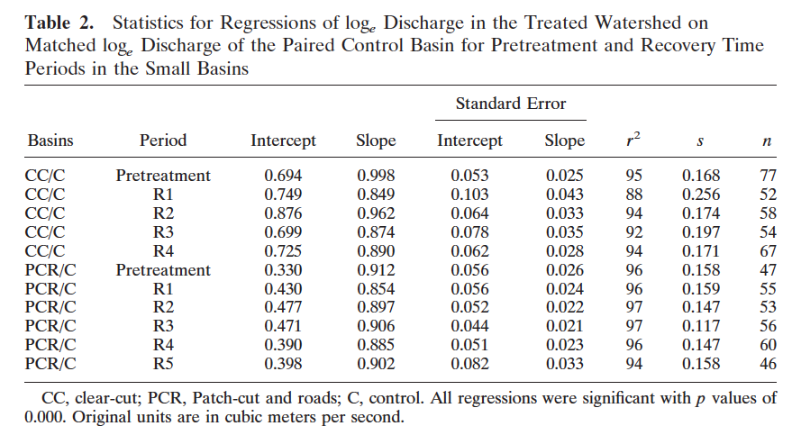
Again, for WS 1,2, and 3, they fit linear regressions between the control and treated watersheds for each period, and then test for differences between the slope and intercept of the regression fits to each period.

Slide 21
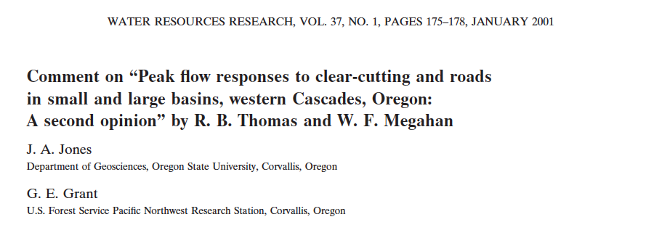
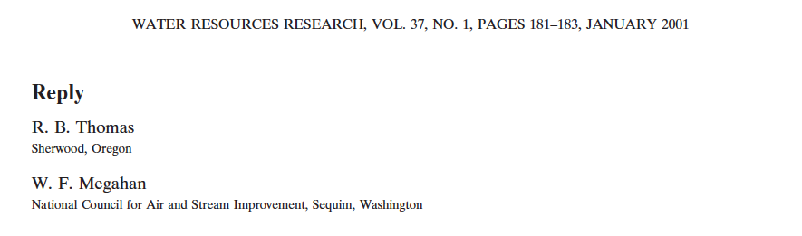
They say ANOVA is the appropriate test, and T&M agree that forest harvesting has increased peak discharge.
They say their results do not agree with J&G. They do not like the four event size categories chosen by J&G. “Large” lumps return periods between 0.4 and 100 years. All event sizes do not respond the same. They also added a time variable to explain that treatment effects decrease over time.

Slide 22
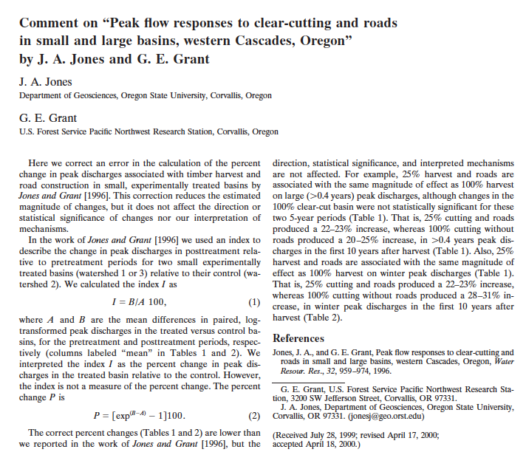
They state that the percent changes were miscalculated and reported too large (because they neglected the fact that they used transformed variables), but all other results are good.

Slide 23
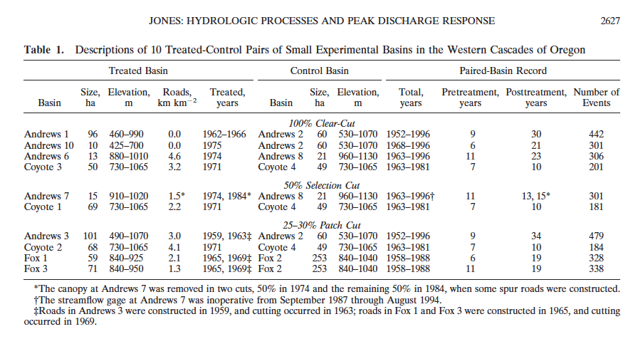
Jones 2000, Also ANOVA, more basins

Slide 24
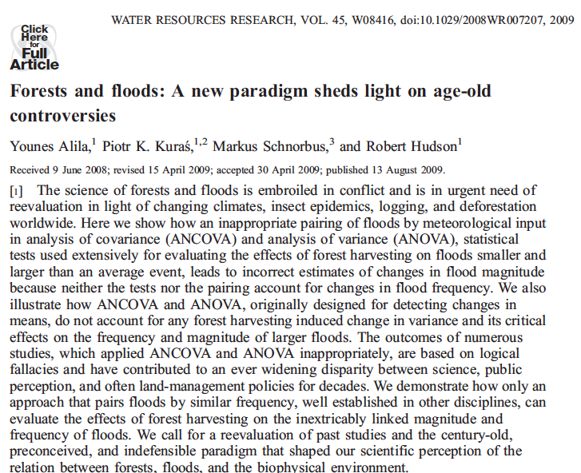
Says ANOVA and ANCOVA are both bad stats choices. Proposes frequency analysis.

Slide 25
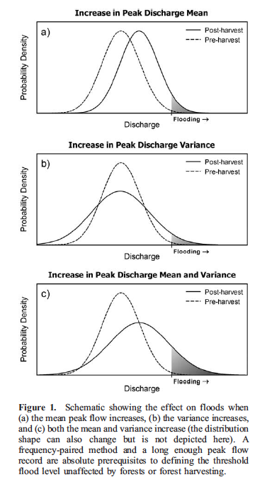
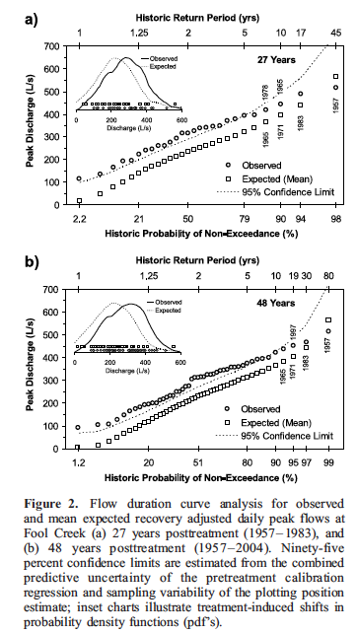
Proposes to compare CDFs of the two time periods
What is “recovery adjusted”?

Slide 26
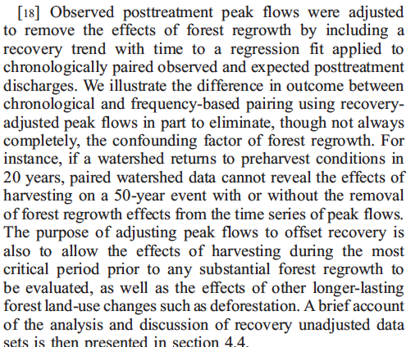
“Recovery adjusted”

Slide 27
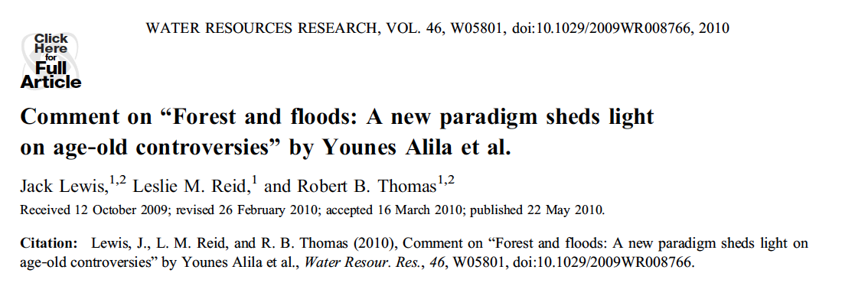
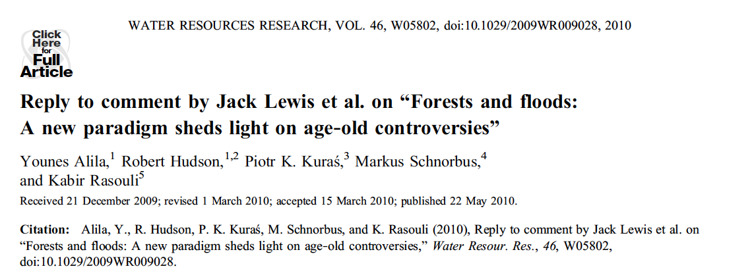
Recovery adjustment is wrong
Analysis of uncertainty applies incorrect parametric assumptions.
Frequency pairing doesn’t overcome fact that there isn’t much data.
Alila is just plain rude regarding other methods.
Chronological and frequency pairing should be used together
Argues that chronological pairing is irrelevant and that most hydrologists are stupid
Includes many quotes highlighting such stupidity

Slide 28
So what can we do?
Can compare ANOVA, ANCOVA, and frequency analysis ourselves for a couple watersheds and see what we think
How do results change with how we group peak flows (what counts as a peak flow)?
How do results change with how we consider recovery after harvesting? How do we calculate recovery? How do we deal with non-stationarity in the timeseries?
What do we think is more important, the choice of statistical test? Or our decisions about flow size and how to control for forest recovery?
Can we invent a fake-dataset that might help us fairly answer these questions?

Slide 29
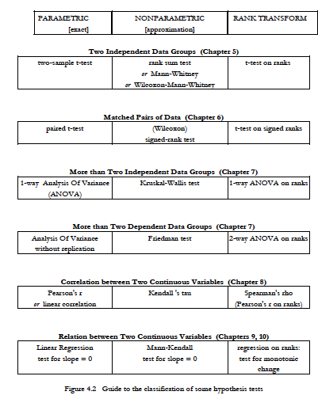
We discussed quantile-mapping and CDFs but did not cover all of the rank transforms in the book
Note that we did not cover these, but they are detailed in the text if you need them in the future.
P 105 Hershel and Hirsch

Slide 30
What can undergrads expect?
Final exam is take-home, posted morning of Dec 2nd and can be uploaded on Monday, Dec 9th (our official exam time)
It will ask questions about which sort of statistical tests you should apply in different situations (similar to following slides and on Homework 7), and may require some computer analysis
It is open book, internet, notes, m-files, but NOT “open friend” – you must write an honor statement the work is your own, and you didn’t talk to anyone about it.
I will plan it to take about 2 hours of your time but will not have a time requirement on it.

Slide 31
Some potential final questions follow:

Slide 32
When should you choose a parametric test vs. a non-parametric test?
Use parametric test on the normally distributed data while if don’t know or not normal distribution, use non-parametric test.

Slide 33
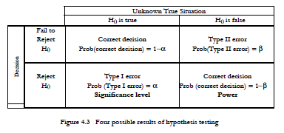
Improperly using a Parametric test will tend to increase your Type II error.
P 107 Hershel and Hirsch

Slide 34
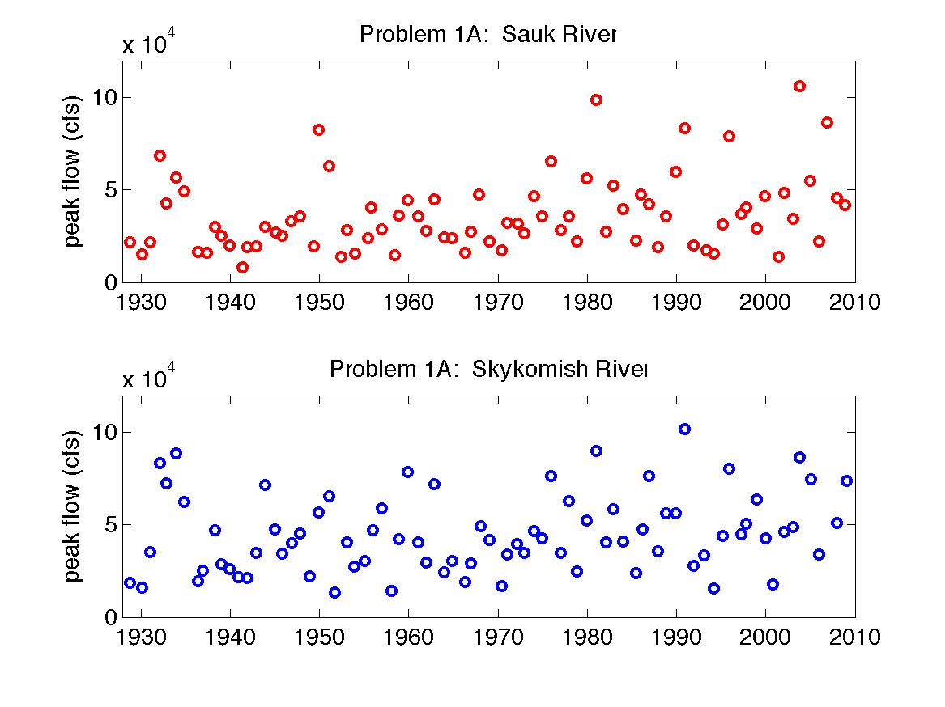
Example: Peak Flows on a River
Take our a piece of paper, write down your own thoughts, then confer with a neighbor.
Q: Any trend? By linear regression, hypothesis test on the slop: if there is any trend. Also calculate for 95% CI
Q: Is variability increasing overtime, break up in time, analyze them in different group
CDF on the data-Q: how the flow changes over time
What questions might we ask?
What tools do we have?
Which tool would be most appropriate to each question?

Slide 35
1. Presume some logging occurred in the watershed in 1970. Are peak flows higher after 1970 than before 1970?
Q1. Have a control
How do you ask this statistically?
What tools should you use?
What should you be careful of / careful about?

Slide 36
2. Presume some logging occurred in the watershed in 1970. Have peak flows become more variable after 1970 than before 1970?
How do you ask this statistically?
What tools should you use?
What should you be careful of / careful about?

Slide 37
3. If the mean annual peak flow has increased to above 50,000 cfs, the town will rebuild the levees. What are the chances that our statistical test would fail to identify this change?
How do you ask this statistically?
What tools should you use?
What should you be careful of / careful about?

Slide 38
4. Has there been a trend in peak flows between 1930 and 2010? How fast are peak flows changing, and is this trend significant?
How do you ask this statistically?
What tools should you use?
What should you be careful of / careful about?

Slide 39
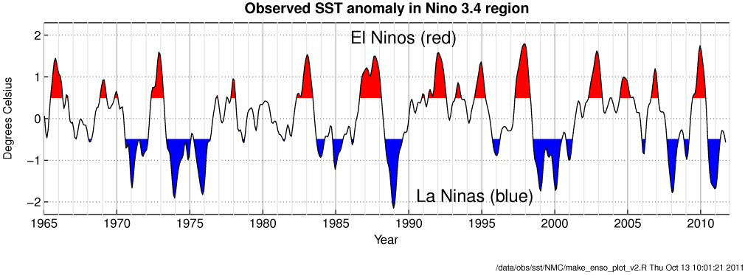
5. If we know that a winter is El Nino, La Nina, or neither (La Nada), can we better predict how high that year’s peak flow will be?
Check correlation with temp and flow?
If no exact numbers for temp but only types, could divide the data according to different types, get different means and do the hypothesis analysis on it.
How do you ask this statistically?
What tools should you use?
What should you be careful of / careful about?

Slide 40
6. A peak flow above 7,500 cfs (blue line) will flood the town. Based on pre-1970 data, a flood this big had a 0.01 chance of occurring any year. Based on post-1970 data, how should we update the chance of flooding?
How do you ask this statistically?
What tools should you use?
What should you be careful of / careful about?

Slide 41
7. The Sauk River gage is getting expensive to maintain. Can we predict the peak flow on the Sauk using measurements on the Skykomish? What accuracy will we have?
Find correlations with two sites.
Use subset for training/testing dataset to test the model
How do you ask this statistically?
What tools should you use?
What should you be careful of / careful about?

